Slide 1

Lariat
Rent-A-Car
1-800-555-9345
Andrew Le’s Capstone Project

Slide 2
Lariat: rent-a-car profitability model
For Lariat Stakeholder
Presented by Andrew Le

Slide 3

Objectives
"No one can remember more than three points.“ - Philip Crosby
Analyzing rental data from Lariat’s fleet for better purchasing decision
Gain insights in order to increase revenue and minimize costs
Create a model that shows projections based percentage increases in revenue

Slide 4

Methods
Excel
Clean and organize raw data
Use pivot table and manipulate the data to gain insights
Dashboards
Develoop summary dashboards to show analysis:
By branch
By make/model
Create a tool that models how changes in inventory can affect revenue

Slide 5
2018 financial analysis
Total Revenue | $52,830,207.00
Total Costs | $27,563,907.20
Total Profit | $25,266,299.80

Slide 6


Optimizing Net revenue
Aim to primarily increase gross revenue
Optimize profit by adding more of top revenue makes/models
Increase revenue
Reduce costs
Limit or reduce makes/models that have high costs from:
Insurance
Car payments
Focus on adding vehicles with high profit margins to the fleet
Low cost/revenue ratio

Slide 7
Options for lowering payment
car_make_and_model | total_revenue | total_car_cost | car_profit | margin
Mitsubishi Endeavor | $ 7,669.00 | $ 7,735.00 | $ (66.00) | -1%
Chevrolet Avalanche 2500 | $ 7,818.00 | $ 7,889.10 | $ (71.10) | -1%
Acura RL | $ 7,045.00 | $ 7,134.50 | $ (89.50) | -1%
Oldsmobile 88 | $ 8,027.00 | $ 8,139.10 | $ (112.10) | -1%
Infiniti M | $ 7,305.00 | $ 7,438.70 | $ (133.70) | -2%
Toyota Solara | $ 8,174.00 | $ 8,376.50 | $ (202.50) | -2%
Dodge Ram 1500 | $ 6,836.00 | $ 7,068.30 | $ (232.30) | -3%
Oldsmobile Regency | $ 8,218.00 | $ 8,538.10 | $ (320.10) | -4%
Dodge Caravan | $ 7,887.00 | $ 8,226.30 | $ (339.30) | -4%
Lincoln Navigator | $ 6,848.00 | $ 7,202.70 | $ (354.70) | -5%
Ford Explorer | $ 6,459.00 | $ 6,991.90 | $ (532.90) | -8%
Volkswagen Passat | $ 6,760.00 | $ 7,326.60 | $ (566.60) | -8%
Audi A5 | $ 7,849.00 | $ 8,557.90 | $ (708.90) | -9%
Honda Civic | $ 7,929.00 | $ 8,657.50 | $ (728.50) | -9%
GMC Yukon | $ 7,684.00 | $ 8,399.20 | $ (715.20) | -9%
GMC Rally Wagon 3500 | $ 6,682.00 | $ 7,362.10 | $ (680.10) | -10%
Bentley Continental | $ 6,822.00 | $ 7,530.20 | $ (708.20) | -10%
Saab 900 | $ 7,799.00 | $ 8,672.20 | $ (873.20) | -11%
Kia Sedona | $ 7,825.00 | $ 8,723.10 | $ (898.10) | -11%
Honda Accord | $ 6,642.00 | $ 7,430.80 | $ (788.80) | -12%
Acura Integra | $ 7,634.00 | $ 8,568.50 | $ (934.50) | -12%
Volvo 850 | $ 7,739.00 | $ 8,693.40 | $ (954.40) | -12%
Toyota Venza | $ 6,303.00 | $ 7,192.90 | $ (889.90) | -14%
Toyota Tundra | $ 6,210.00 | $ 7,119.20 | $ (909.20) | -15%
Suzuki Kizashi | $ 6,465.00 | $ 7,418.30 | $ (953.30) | -15%
Audi 5000CS | $ 7,206.00 | $ 8,344.00 | $ (1,138.00) | -16%
Oldsmobile Toronado | $ 7,491.00 | $ 8,718.00 | $ (1,227.00) | -16%
Pontiac LeMans | $ 7,058.00 | $ 8,285.20 | $ (1,227.20) | -17%
Toyota MR2 | $ 6,233.00 | $ 7,458.70 | $ (1,225.70) | -20%
Buick Century | $ 5,575.00 | $ 6,784.00 | $ (1,209.00) | -22%
Mercedes-Benz CL-Class | $ 6,813.00 | $ 8,523.60 | $ (1,710.60) | -25%
Ford Escort | $ 6,211.00 | $ 7,784.50 | $ (1,573.50) | -25%
Honda Pilot | $ 6,437.00 | $ 8,137.80 | $ (1,700.80) | -26%
Honda CR-V | $ 5,322.00 | $ 6,826.10 | $ (1,504.10) | -28%
Jaguar XJ Series | $ 5,456.00 | $ 7,070.20 | $ (1,614.20) | -30%
Volkswagen Type 2 | $ 5,792.00 | $ 8,100.80 | $ (2,308.80) | -40%
Daewoo Nubira | $ 5,921.00 | $ 8,356.60 | $ (2,435.60) | -41%
Jaguar XJ Series | $ 5,791.00 | $ 8,507.50 | $ (2,716.50) | -47%
Jaguar XJ Series | $ 5,297.00 | $ 7,984.70 | $ (2,687.70) | -51%
Mercury Grand Marquis | $ 5,311.00 | $ 8,818.10 | $ (3,507.10) | -66%
Remove vehicles that have a higher cost than revenue
Removal of these vehicles would remove about $41.5k in negative profit
Table to the right shows all the vehicles that had a negative profit
Total revenue: | $ 274,543.00
Total cost: | $ 316,091.90
Net profit: | $ (41,548.90)

Slide 8
Make/model insights
Below are some charts that illustrate some of the most profitable vehicles, as well as least profitable, and top vehicles by average margin

Slide 9
Branch insights
Below are some charts used to illustrate the top branches by revenue, as well has the lowest branches by revenue.
The last chart shows that branches attached to airport did not do as well as branches that were not, as some might suspect.

Slide 10
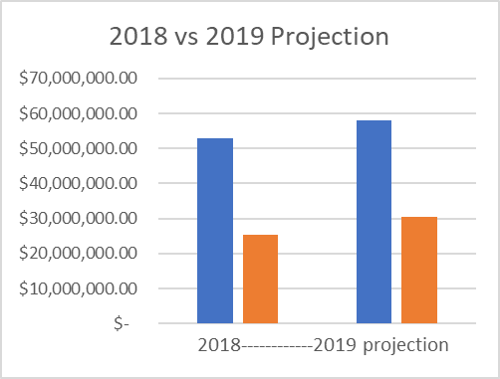
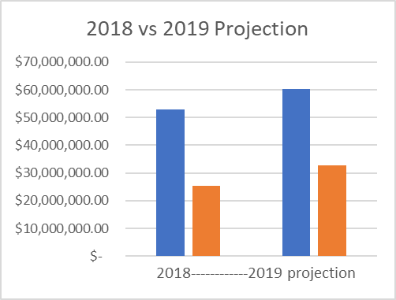
Comparing strategies
Increasing Gross Revenue by 10%
In comparing these strategies, you can refer to the model sheet in the accompanying excel workbook for increasing revenue and increasing top quarter of units
You can refer to neg_profit sheet for the removal of vehicles that have a higher cost than revenue or the options for lowering payment slide
Increase Top Quarter Units by 2%

Slide 11
Summary:
Some of the options to increase revenue and decrease costs include
Reducing the vehicles that have a higher cost than profit
Increase the top 25% vehicles with the highest profit
Branches associated with an airport did not necessarily do better than those that were not attached
For specific tools and dashboards to with specific tools, please refer to the accompanying model that was associated with the excel sheet that was sent
OneDrive
Or Google Drive

